Slide 1
A1 group work
Pre-production

Slide 2
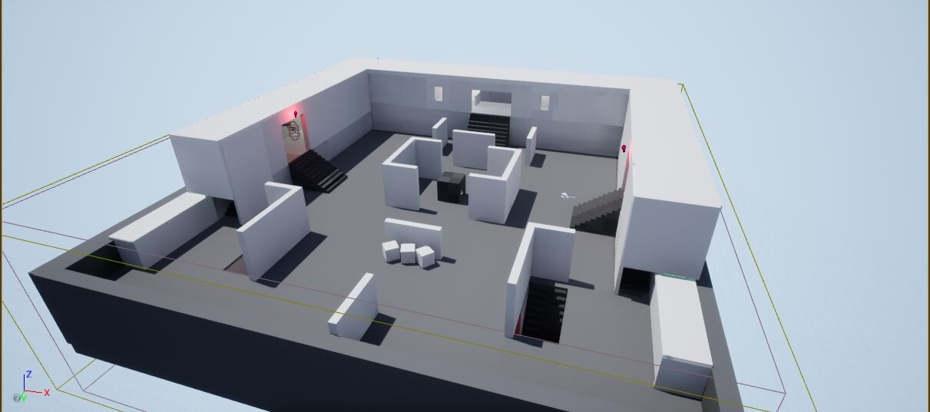
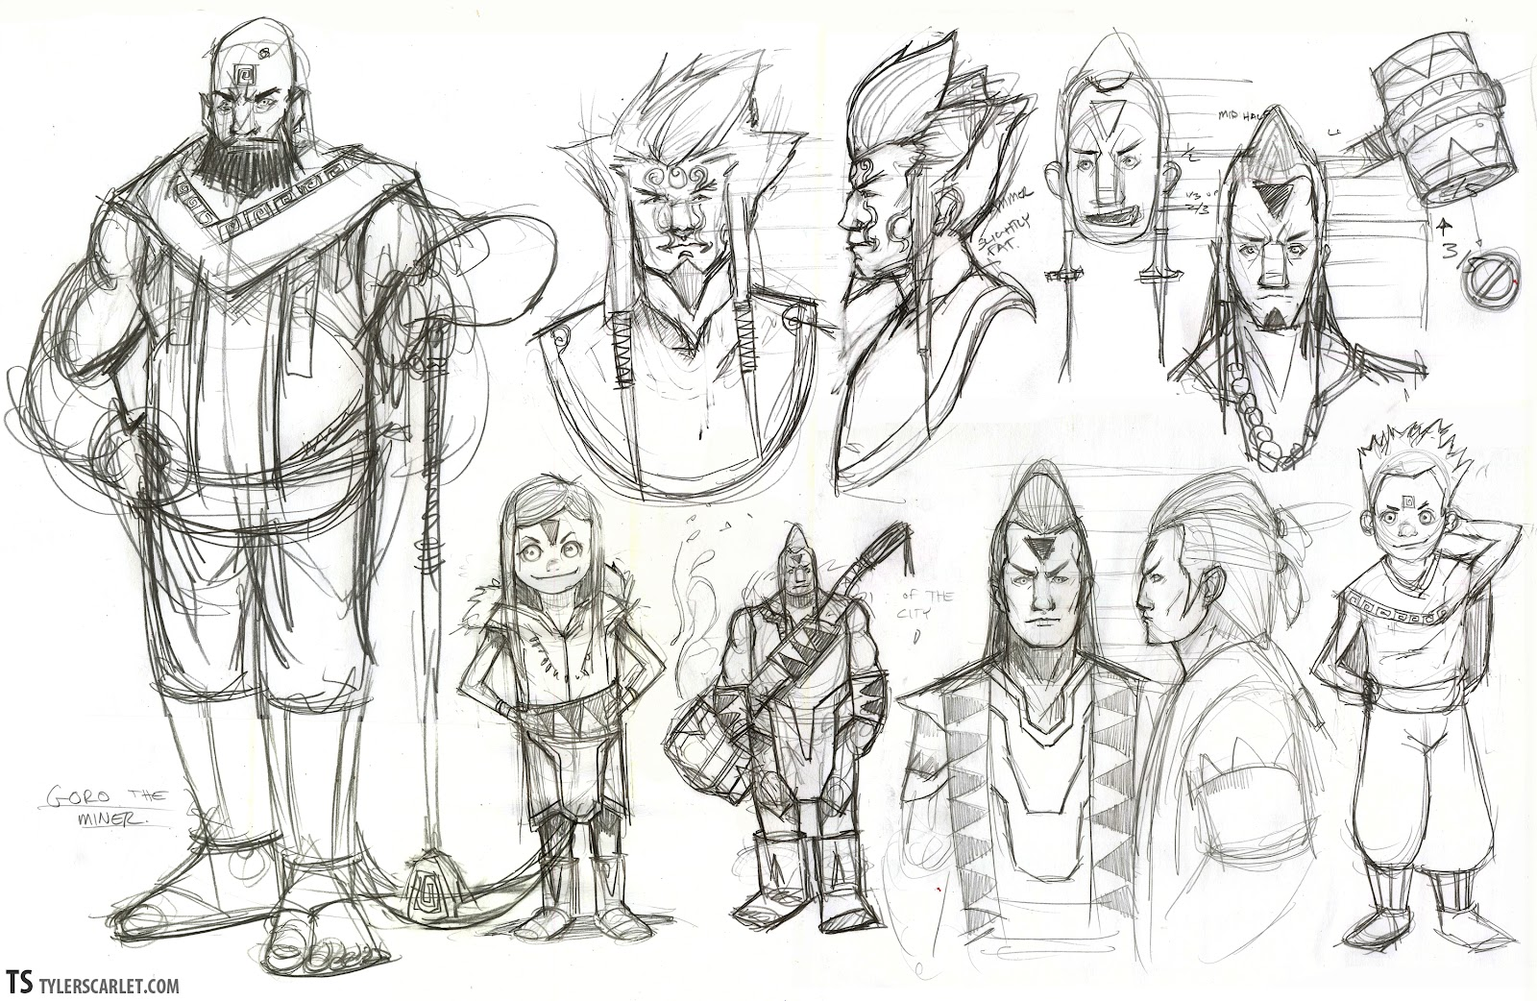
Prototyping
This step is later into the pre-production phase and there are different forms of prototyping such as:
White boxing-Making a rough outline of the game world with primitive shapes in order to test the game mechanics
Sketching assets and models-making quick simple drawings of items and assets in game
Vertical prototyping-focusing on a singular aspect in detail
Horizontal prototyping-Creating an over simplified version of the game
Sources:
accelbyte.io
Whitebox level
juu69.blogspot.com

Slide 3
Finding a Demographic and Main Game Concept
Sources:

Slide 4
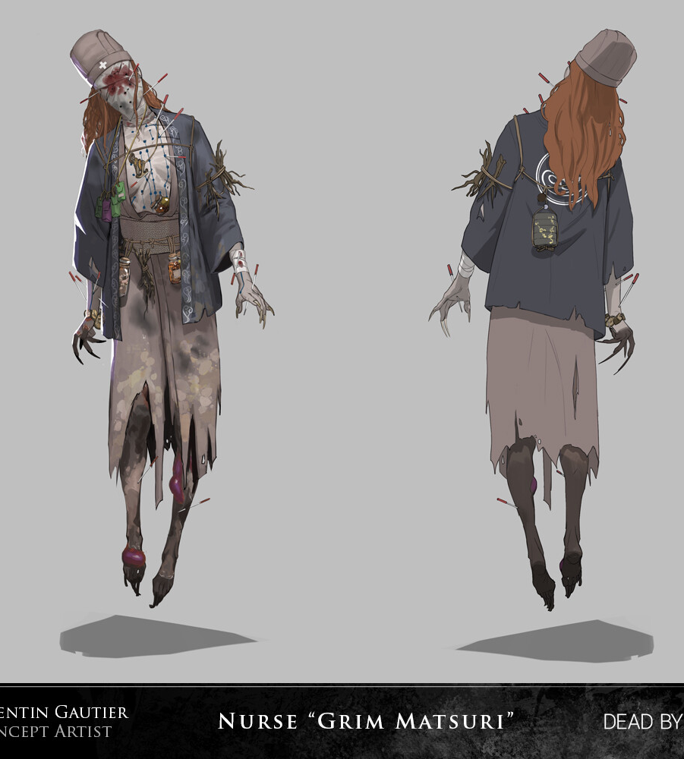
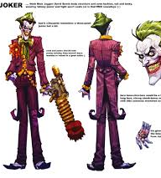

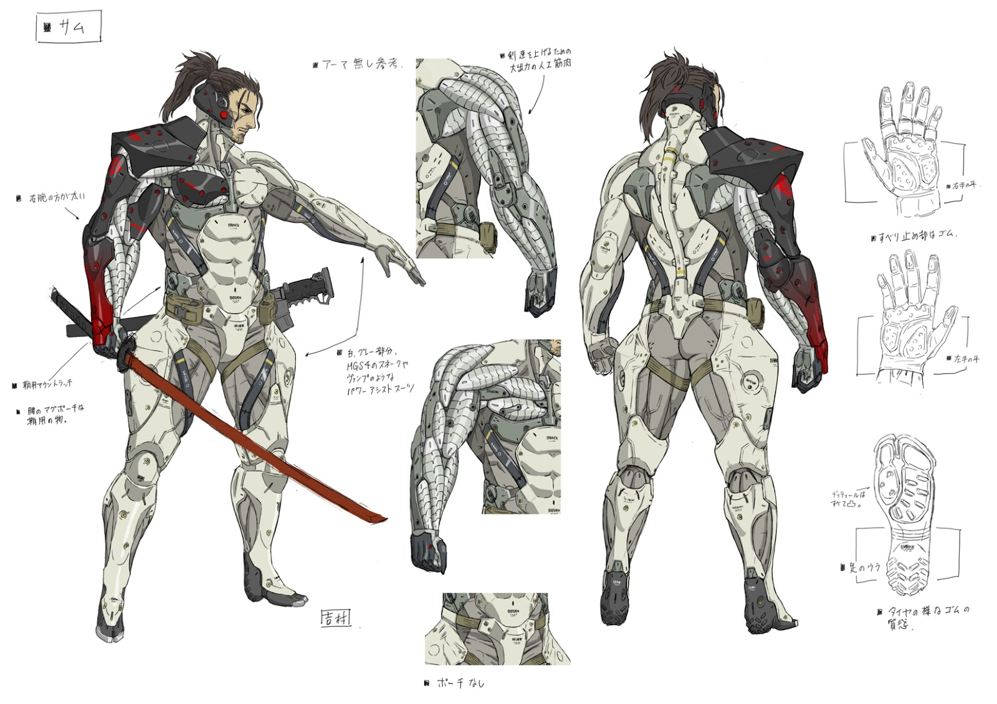
Idea generation
A large part of a pre-production plan is to actually think up ideas and concepts. It’s a good point to think up game mechanics, story and character designs. This is the main concept art area. Lots of things can be scrapped mainly story and character designs. Past media work is another way to generate ideas. Working on a scrapped concept that wasn’t liked to make it more appealing to add to the game like building on others is another part

Slide 5
Taking inspiration
Many games take inspiration from past games, films and books, artworks. Some examples would be

